Slide 1
Project Title:
Heart Disease Prediction
Name:
Ravin.A
College Name:
Madras Institute of Technology, Anna University
NM ID:
861BD804D0DD680B45C41C00BE0A4CE2
3/21/2024 Annual Review

Slide 2


AGENDA
Introduction
Problem Statement
Project Overview
End Users
Solution and Value Proposition
The Wow in Solution
Modelling
Results
3/21/2024 Annual Review

Slide 3
PROJECT TITLE: Heart Disease Prediction
Introduction to the project:
Heart disease remains one of the leading causes of mortality worldwide, emphasizing the critical need for effective predictive tools to identify individuals at risk. In recent years, advancements in machine learning have provided promising avenues for developing accurate and efficient predictive models for heart disease risk assessment.
This project aims to leverage machine learning techniques to predict the likelihood of heart disease in individuals based on a range of clinical and demographic attributes.
By analyzing comprehensive datasets containing information such as patient demographics, medical history, and diagnostic test results, the goal is to develop a robust predictive model capable of identifying individuals with heightened risk factors for heart disease.
3/21/2024 Annual Review

Slide 4

PROBLEM STATEMENT
Heart disease remains a significant global health issue, requiring early detection and intervention. Traditional risk assessment methods often lack precision for proactive intervention.
The problem at hand is to develop a reliable and accurate predictive model for assessing the risk of heart disease in individuals. This model should leverage machine learning techniques to analyze comprehensive datasets containing clinical and demographic information, with the aim of identifying individuals at heightened risk of developing heart disease.
3/21/2024 Annual Review

Slide 5

PROJECT OVERVIEW
The primary objective of this project is to develop a machine learning model capable of accurately predicting the risk of heart disease in individuals based on various clinical and demographic factors. By leveraging advanced predictive analytics techniques, the project aims to enhance early detection and intervention strategies for mitigating the burden of heart disease on individuals and healthcare systems.
Methodology:
Data Collection and Preprocessing: Comprehensive datasets containing relevant attributes associated with heart disease, such as patient demographics, medical history, and diagnostic test results, will be collected from diverse sources. Data preprocessing techniques, including cleaning, encoding categorical variables, handling missing values, and normalization, will be applied to ensure data quality and consistency.
Feature Selection and Engineering: Key features strongly correlated with heart disease risk will be identified through exploratory data analysis and statistical techniques. Feature engineering methods, such as polynomial features, interaction terms, and dimensionality reduction, will be employed to enhance predictive performance and interpretability.
3/21/2024 Annual Review

Slide 6

WHO ARE THE END USERS?
Healthcare Practitioners:
Patients
Healthcare Organizations
Health Insurance Companies
Public Health Authorities
3/21/2024 Annual Review

Slide 7

SOLUTION AND ITS VALUE PROPOSITION
The heart disease prediction model developed in this project leverages advanced machine learning techniques to accurately assess an individual's risk of developing heart disease. By analyzing comprehensive datasets containing clinical and demographic information, the model provides personalized risk predictions, enabling proactive intervention strategies and personalized patient care.
3/21/2024 Annual Review

Slide 8
THE WOW IN SOLUTION
Personalization: The solution provides personalized risk assessments tailored to each individual's unique characteristics, offering insights into their specific risk factors for heart disease. This level of customization empowers both healthcare practitioners and patients to make informed decisions and take proactive steps towards better heart health.
Early Intervention: By detecting individuals at heightened risk of heart disease early on, the solution enables timely intervention with targeted preventive measures and treatment strategies. This proactive approach can significantly improve patient outcomes and reduce the burden of heart disease on both individuals and healthcare systems.
Predictive Accuracy: Leveraging advanced machine learning techniques, the solution delivers accurate predictions of heart disease risk based on comprehensive datasets containing clinical and demographic information. This high level of predictive accuracy instills confidence in healthcare practitioners and ensures that interventions are targeted towards those who need them most.
3/21/2024 Annual Review

Slide 9
MODELLING
Logistic Regression: Despite its name, logistic regression is a linear model used for binary classification tasks. It calculates the probability of an instance belonging to a certain class using a logistic function. It's simple, interpretable, and works well for linearly separable data.
Naive Bayes: Naive Bayes classifiers are based on Bayes' theorem with the assumption of independence between features. Despite this simplifying assumption, they can perform surprisingly well in many real-world situations and are particularly useful for text classification tasks.
Support Vector Machine (SVM): SVMs are powerful supervised learning models used for classification and regression analysis. They find the optimal hyperplane that separates data into different classes while maximizing the margin between classes. SVMs can handle high-dimensional data and are effective in cases where the data is not linearly separable.
K-Nearest Neighbors (KNN): KNN is a simple and intuitive algorithm that classifies an instance by a majority vote of its neighbors. It's a non-parametric method that doesn't make any assumptions about the underlying data distribution. KNN can be sensitive to the choice of the number of neighbors (k) and the distance metric used.
.
3/21/2024 Annual Review

Slide 10
MODELLING
Decision Tree: Decision trees recursively split the data based on the features' values to create a tree-like structure. Each internal node represents a "decision" based on a feature, and each leaf node represents a class label. Decision trees are easy to interpret and can handle both numerical and categorical data.
Random Forest: Random Forest is an ensemble learning method that constructs multiple decision trees during training and outputs the mode of the classes (classification) or the average prediction (regression) of the individual trees. Random Forest mitigates overfitting and improves generalization compared to individual decision trees.
XGBoost: XGBoost (Extreme Gradient Boosting) is a scalable and efficient implementation of gradient boosting machines. It builds a series of weak learners (typically decision trees) sequentially, with each learner correcting the mistakes of its predecessors. XGBoost is known for its speed and performance in various machine learning competitions.
Neural Network: Neural networks, particularly deep learning models, have gained popularity for their ability to learn complex patterns from data. They consist of interconnected layers of neurons that learn hierarchical representations of the input data. Neural networks can automatically extract features from raw data and have shown remarkable performance in various classification tasks.
.
.
.
3/21/2024 Annual Review

Slide 11
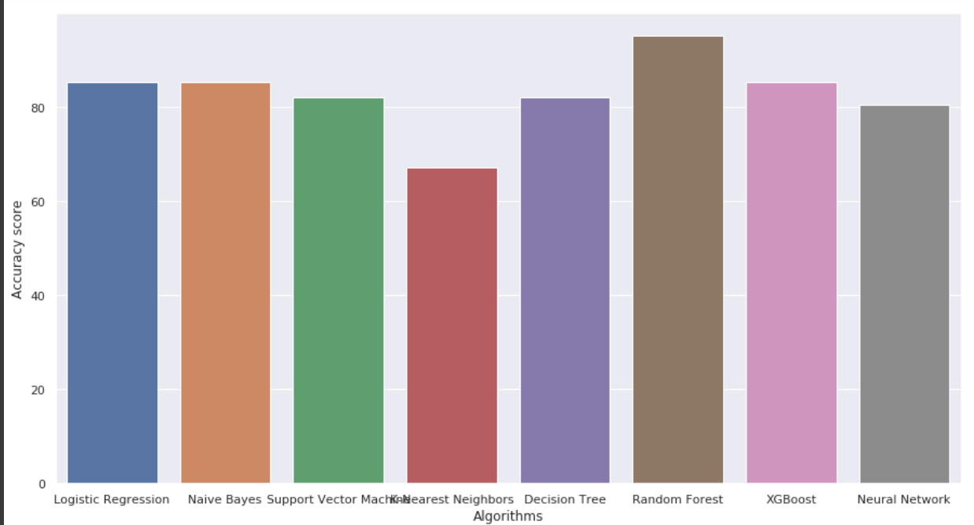
MODEL COMPARISON
3/21/2024 Annual Review

Slide 12
RESULTS
TEST CASES
The accuracy score achieved using Logistic Regression is: 85.25 %
The accuracy score achieved using Naive Bayes is: 85.25 %
The accuracy score achieved using Support Vector Machine is: 81.97 %
The accuracy score achieved using K-Nearest Neighbors is: 67.21 %
The accuracy score achieved using Decision Tree is: 81.97 %
The accuracy score achieved using Random Forest is: 95.08 %
The accuracy score achieved using XGBoost is: 85.25 %
The accuracy score achieved using Neural Network is: 80.33 %
Demo Link:https://drive.google.com/file/d/10TudOgd39OHHquIhp8yq26sdPJF6gt5y/view?usp=sharing
3/21/2024 Annual Review

